Slide 1
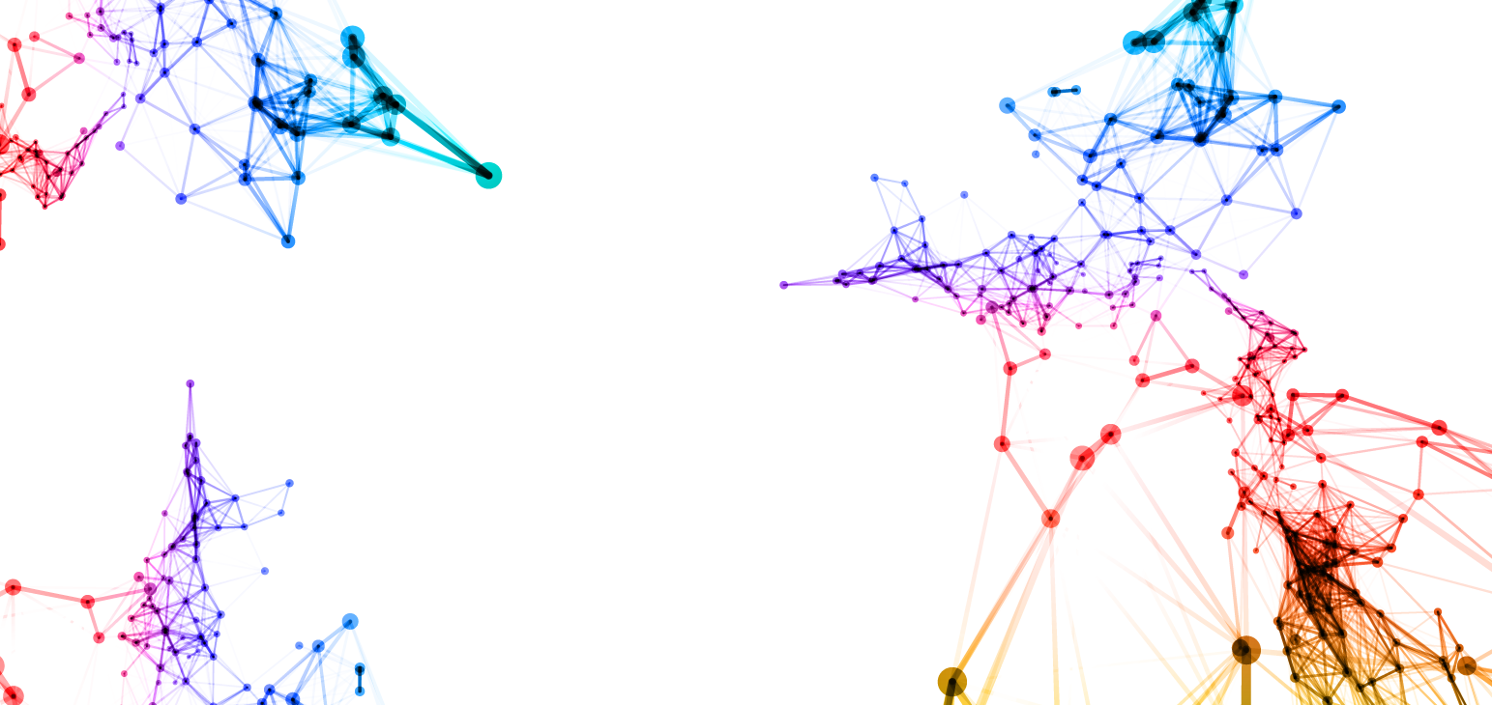
Kansas State University Foundation Twitter Follower Analysis
Jeremy Larson

Slide 2
Project Objectives
How can we derive greater value from our use of social media, in this case Twitter, beyond the basic measures used now?
Can we get a better understanding of what our followers are interested in?
Are we crafting messaging that is engaging to our followers?
Can we identify the followers that are most engaged in our follower network?
Have we previously developed a relationship with that follower?
Is there some way to co-op them into helping us spread our messaging?
Could identifying and engaging key followers be used as a new measure of success for our social media process?

Slide 3
Data Collection Method
Data Collection Method: Twitter API and Python
Python code was written in Notepad++ and ran via the Windows Command Prompt
Two step Process
First, collect all the Twitter followers of the Kansas State University Foundation
2,507 followers as of 04/25/2017 when the data was collected
Second, collect tweets from all the KSUF followers whose profiles are not set to private
2,035,331 tweets collected
Data Filtering Method for Data Analysis: Microsoft SQL Server 2016
Created table in SQL Server 2016 via the SQL Server Management Studio tool
Queried only the most recent two weeks of tweets (04/11/2017-04/25/2017) to have a reasonably sized dataset for analysis
29,883 tweets created in that two week span

Slide 4
Data Analysis Techniques
Data analysis was completed in Python and NodeXL
Descriptive Analytics
Utilized Anaconda Python and Jupyter Notebook for analysis
Topic Modeling
Utilized Anaconda Python and Jupyter Notebook for analysis
Sentiment Analysis
Utilized Anaconda Python and Jupyter Notebook for analysis
Network Analysis
Utilized Anaconda Python, Jupyter Notebook, and NodeXL for analysis

Slide 5
Descriptive Analytics
Descriptive Analytics is the examination of data or content to answer the question “What happened?” or “What is happening?”

Slide 6
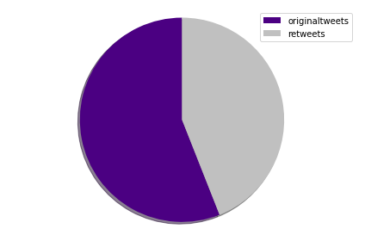
Descriptive Analytics
Dataset timeframe: 04/11/2017-04/25/2017
Unique followers: 1,143
Tweets collected: 29,883
Average number of tweets per follower: 26
Original tweets: 16,731
Retweets: 13,152

Slide 7
Descriptive Analytics (cont.)
Top 10 most active followers:
Top 10 most mentioned twitter users:
Twitter Name Tweet Count
thekstatefamily 1105
LR4KSU 887
jamesrecruits 842
hootsuite 615
mfuentessanchez 595
wildkatphoto 512
AgweekMagazine 422
AAUW 363
pjscout 361
ksucats96 347
Twitter Name Mentioned Count
@hallmarkchannel 697
@kstate 362
@wcth_tv 289
@kstatebsb 227
@kstatefb 195
@kellisrobinett 185
@erinkrakow 181
@kstatesports 165
@brbird 140
@emisorasunidas 139

Slide 8
Descriptive Analytics (cont.)
Top 10 most used hashtags:
What is #hearties used for?
Hashtag Count
#hearties 719
#kstate 558
#kstatefb 195
#kstatebsb 185
#hootchat 116
#ksleg 111
#emaw 101
#family 86
#standuptosexism 81
#jobseekers 79
#hearties is used for the Hallmark Channel show “When Calls the Heart” (@wcth_tv) that concluded its fourth season and was announced to be renewed for a fifth season during the time period observed. This will also explain the Hallmark Channel being the most mentioned Twitter user in the previous slide.

Slide 9
Descriptive Analytics (cont.)
TOP 10 MOST LINKED URLS: (follow at your own risk)
URL Count
http://careermarketplace.org/ 160
http://www.aauw.org/event/2017/03/tune-in-for-our-panel-on-how-to-standuptosexism/ 55
https://www.thetournament.com/teams/purple-and-black-kansas-state-alumni-0 27
https://twitter.com/carterjwm/status/849813577770778624/photo/1 23
https://twitter.com/kstatesports/status/852987970466365440/photo/1 20
https://shipsims.com/ 15
http://collegefootball.ap.org/article/k-state-could-feature-nations-top-group-running-backs 13
https://twitter.com/KStateProvost/status/855455136856117248/photo/1 13
https://twitter.com/kstatesports/status/855842992917159936/video/1 13
http://www.k-state.edu/media/newsreleases/2017-04/artscidean41417.html 12

Slide 10
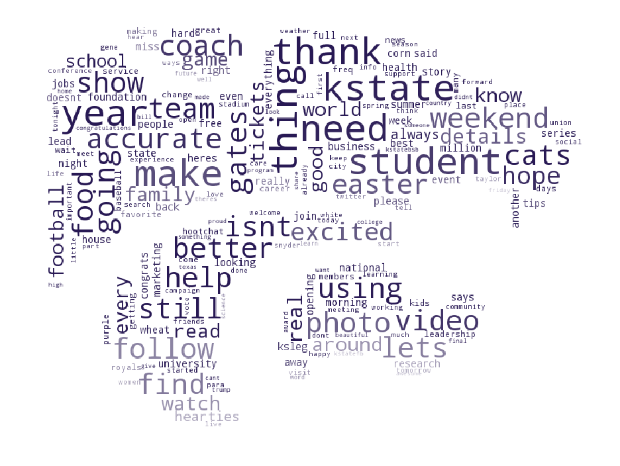
Descriptive Analytics (cont.)

Slide 11
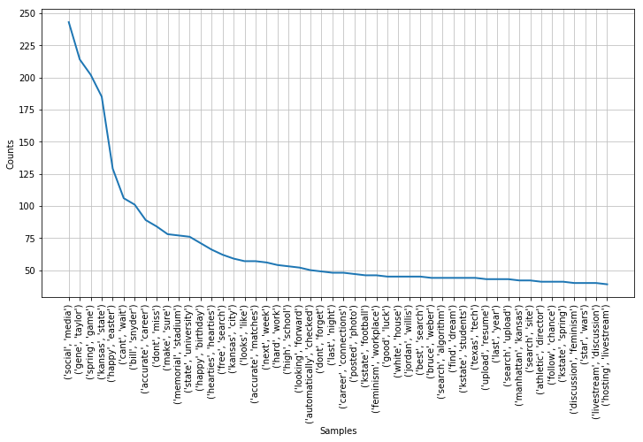
Descriptive Analytics (cont.)
TOP 10 MOST USED WORD PAIRS:
Word pair distribution:
Word Pair Count
Social Media 243
Gene Taylor 214
Spring Game 202
Kansas State 185
Happy Easter 129
Can’t Wait 106
Bill Snyder 101
Accurate Career 89
Don’t Miss 84
Make Sure 78

Slide 12
Topic Modeling
a topic model is a type of statistical model for discovering the abstract "topics" that occur in a collection of documents. Topic modeling is a frequently used text-mining tool for discovery of hidden semantic structures in a text body.

Slide 13
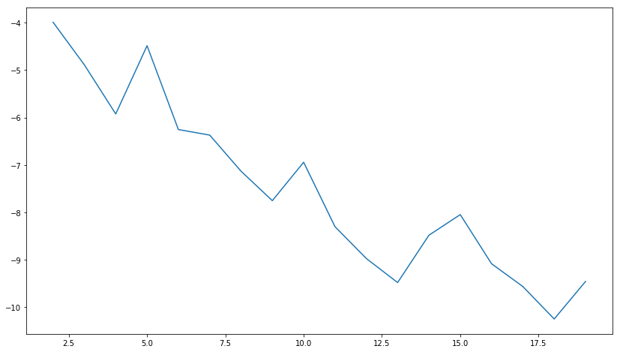
Topic Modeling
Testing for number of topics
Model testing output (larger is better)
Testing was completed to find the best fit for data between 2 and 20 topics.
Each number of topics were passed thru the model 75 times to ensure accuracy.
The model substantiated that two topics was the best fit for the data.
Model testing was a very long process for this amount of data (approximately 10 hours).

Slide 14
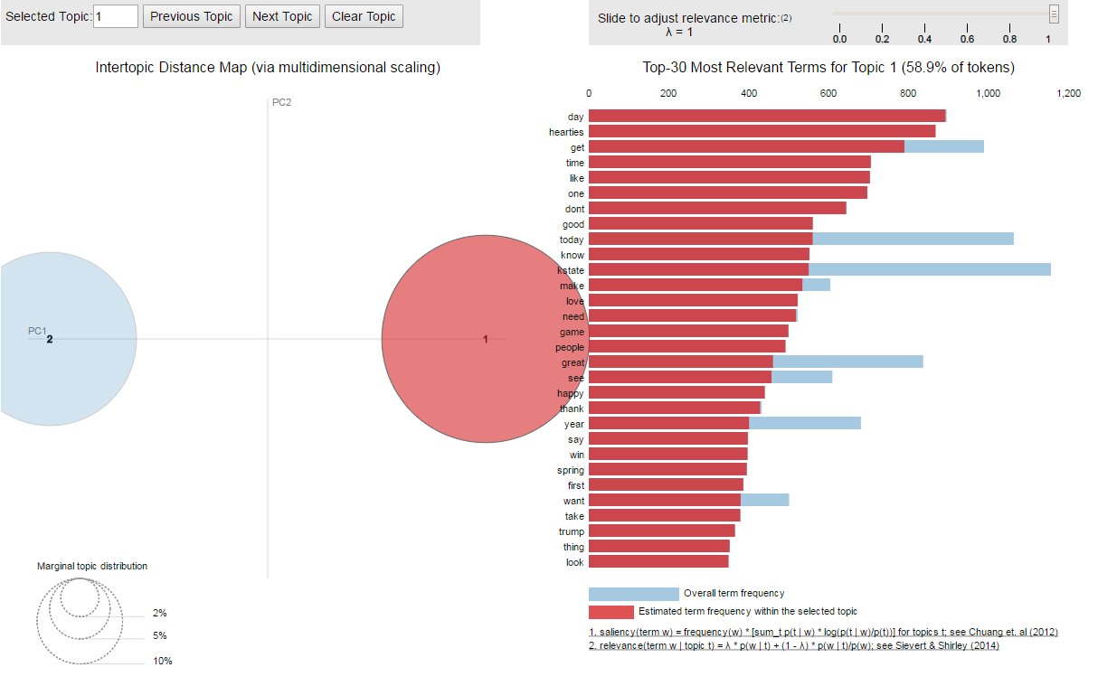
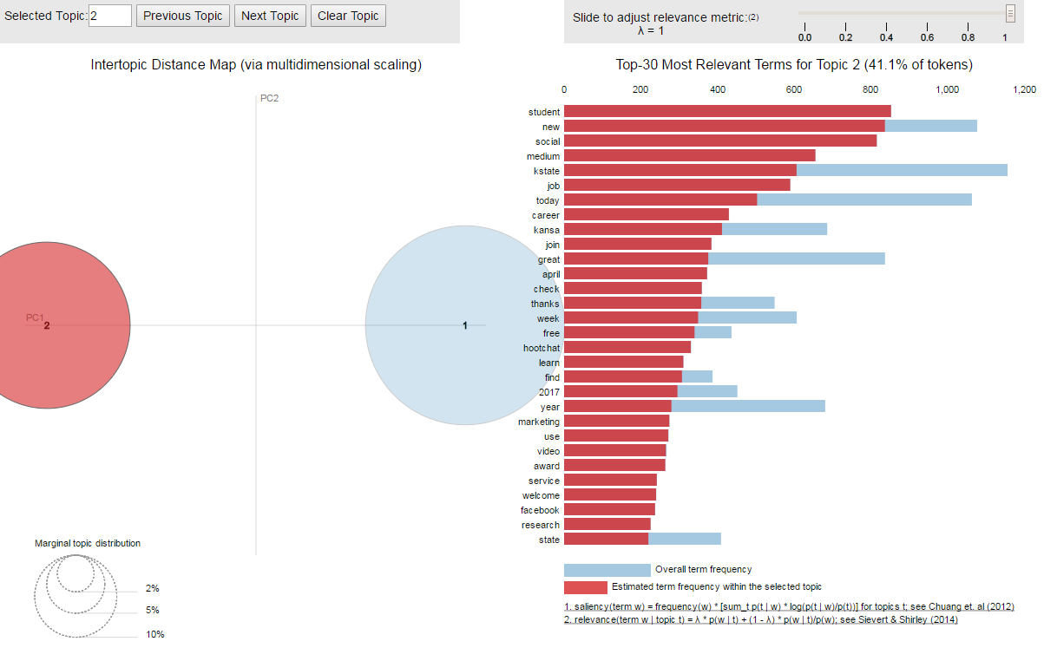
Topic Modeling (cont.)
Topic 1
Topic 2

Slide 15
Topic Modeling (cont.)
Topic 1 Top 10 most relevant words
Topic 2 Top 10 most relevant words
Day
Hearties
Get
Time
Like
One
Don’t
Good
Today
Know
Student
New
Social
Medium
KState
Job
Today
Career
Kansas
Join

Slide 16
Topic Modeling (cont.)
Topic Modeling Conclusions:
Topic 2 is pretty clear that it is concerning Kansas State University students and their careers.
It being near the end of the spring semester and graduation supports the notion of this being a major topic of discussion.
Topic 1 is less clear however.
Hearties as seen in the Descriptive Analytics is a clear shout out to the Hallmark Channel show but “Kstate”, “Game”, and “Spring”, words 11, 15, and 24 in Topic 1’s relevant terms, do not fit that topic.
Speculation: As seen in the Descriptive Analytics, there is a large amount of discussion around Kansas State Athletics. However, it was spread across multiple different key words, hashtags, and Twitter mentions. I believe this is a case were the fracturing of the topic over multiple subtopics prevented the model from reaching critical mass for the topic overall to be elevated to its own designated topic.

Slide 17
Sentiment Analysis
Sentiment analysis refers to the use of natural language processing, text analysis, and computational linguistics to systematically identify, extract, quantify, and study affective states and subjective information. Sentiment analysis is widely applied to voice of the customer materials such as reviews, survey responses, and online and social media for applications that range from marketing to customer service.

Slide 18
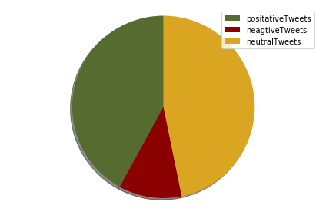
Sentiment Analysis
Sentiment analysis was performed and found that:
12,270 tweets were positive
3,262 tweets were negative
13,658 tweets were neutral
The tweet count will not equal the total number of tweets due to the data cleaning process.

Slide 19
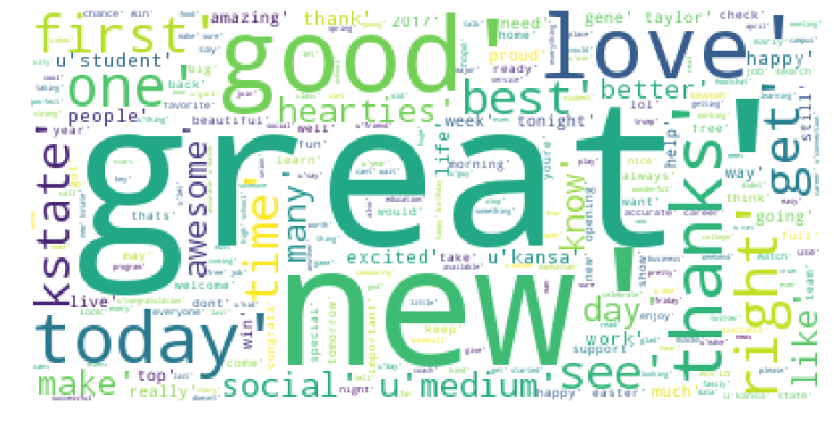
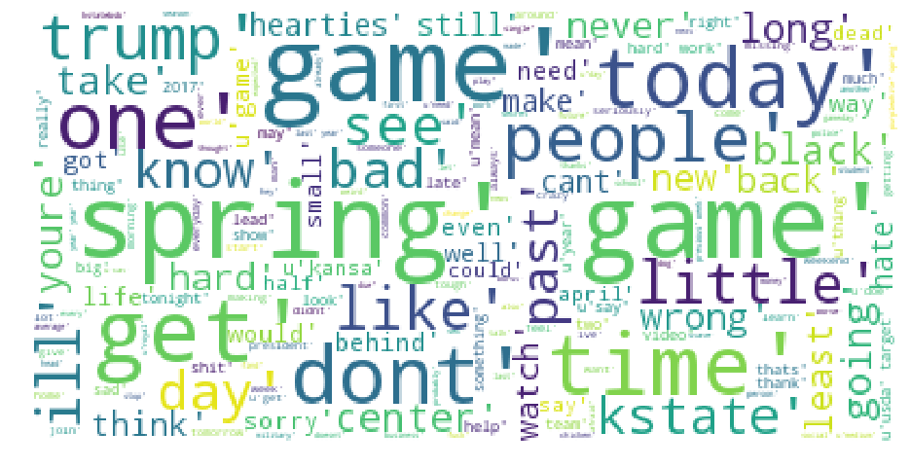
Sentiment Analysis (cont.)
Positive sentiment word cloud
Negative sentiment word cloud

Slide 20
Sentiment Analysis (cont.)
Sentiment Analysis Conclusions:
Initially confused by the findings of the negative sentiment word cloud showing the K-State Spring Football game as a large contributor.
After manual review of the tweets in the dataset the conclusion now makes more sense:
Many of the tweets in the dataset discuss several of the players sitting out the game “injured”, that the hurt players should not play in a “meaningless” game to avoid re-injury, and that there were many position “battles” to watch for during the game. These key words, and others, in the tweets are treated as words with a negative meaning association and attributed to the Spring Game showing up in such a large manner in the negative sentiment analysis.
Other tweets that may have contained curse words and things of that nature may have also been treated as having a negative cogitation.

Slide 21
Network Analysis
network analysis is the process of investigating social structures through the use of networks and graph theory. It characterizes networked structures in terms of nodes (individual actors, people, or things within the network) and the ties, edges, or links (relationships or interactions) that connect them.

Slide 22
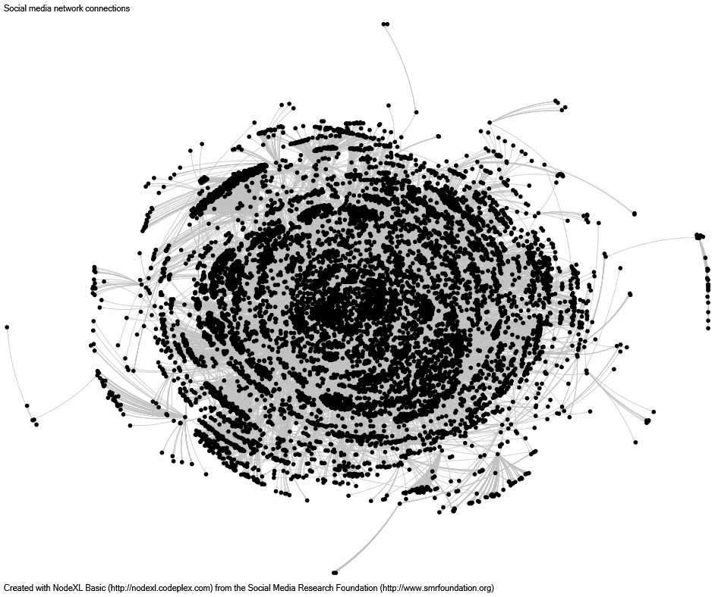
Network Analysis
Mention network defined
Mention network graph
The mention network investigates how the followers of the Kansas State University Foundation interact with other Twitter users by mentioning them in their tweets.
This is useful for identifying who is directly tweeting the Foundation, university, and/or other university affiliates to determine affinity.
This network has a maximum Geodesic distance of 14 and an average Geodesic distance of 5.62. Meaning it is not a centralized network with everyone in it very loosely tied to each other.

Slide 23
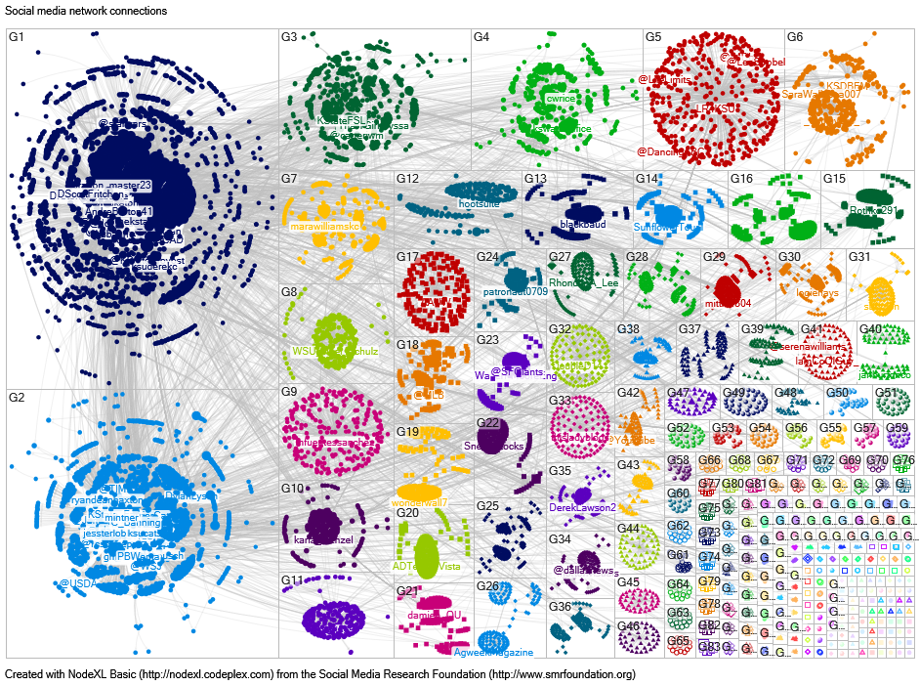
Network Analysis (cont.)
Mention network further analysis
Mention network group graph
The network is analyzed and color shaded and broken into those that belong to the same group.
The top 100 followers with the largest Betweenness Centrality have their label appended to their node.
Betweenness Centrality is a measure of centrality in a graph based on shortest paths. In essence, those with a high Betweenness Centrality act as bridges from one part of the network to another.

Slide 24
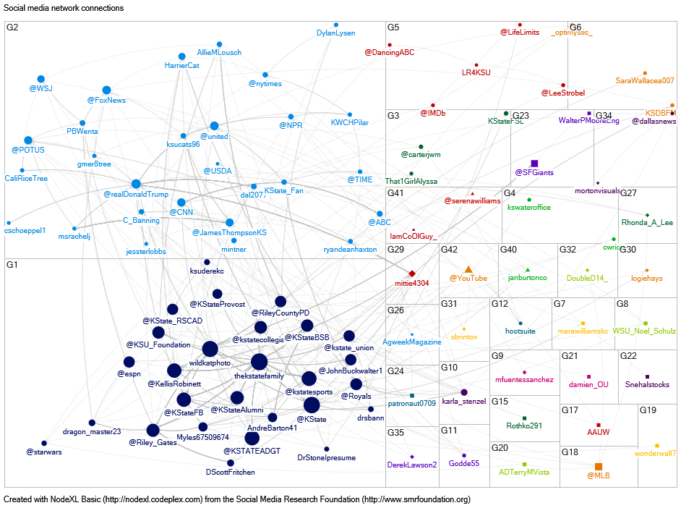
Network Analysis (cont.)
Mention network even more analysis
Only key follower Mention network
Further analysis and manipulation was conducted to determine who are most important nodes in the network and only display them.
The size of the node is determined by their Eigenvector Centrality.
Eigenvector centrality is a measure of the influence of a node in a network. In this graph, the more influence the node has, the larger it is displayed.

Slide 25
Network Analysis (cont.)

Slide 26
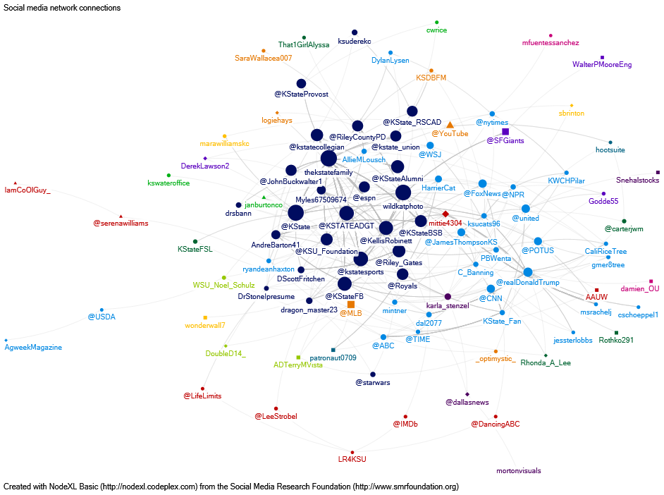
Network Analysis (cont.)

Slide 27
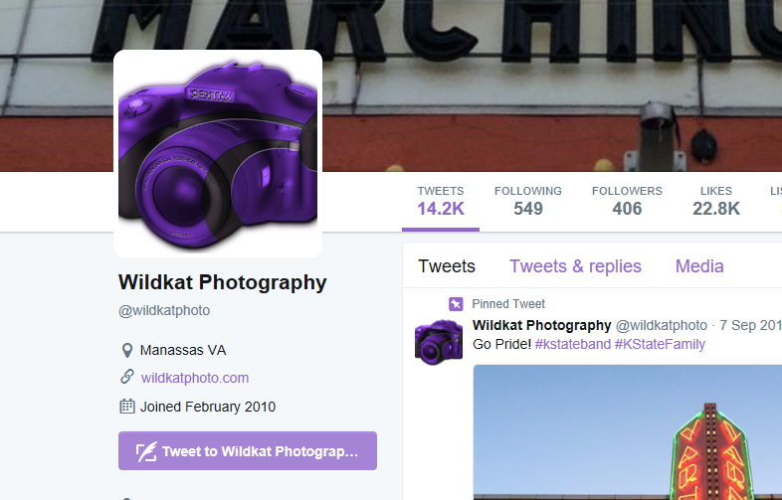
Network Analysis (cont.)
only key follower Mention network
Key follower to Evaluate Example
Using only the key followers in the mention network reduces the maximum Geodesic distance down from 14 to 6 and the average Geodesic distance from 5.62 to 3.05.
This network is still considered loosely connected but is much more centralized than the overall network.
The initial wave of key followers to evaluate are identified as being in Group 1: The “K-State” group.
Additional criteria:
Not recognizable as being directly affiliated with K-State
Not a recognizable company (i.e. @espn)
Have a large Eigenvector score.

Slide 28
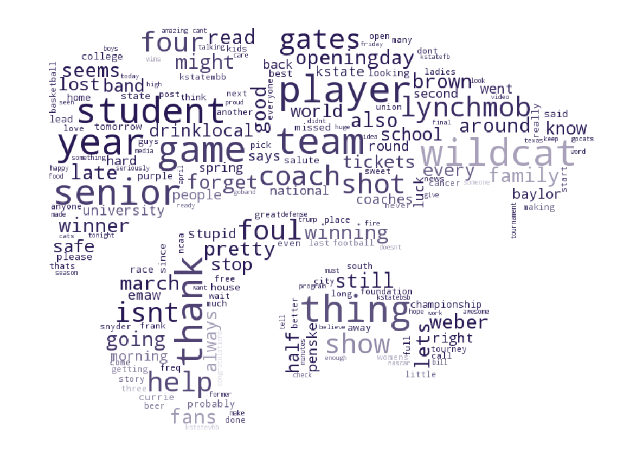
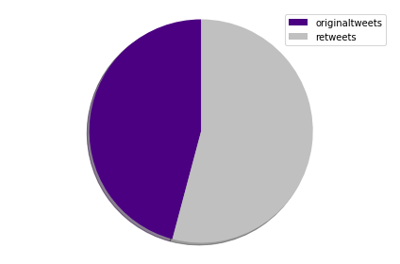
Network Analysis (cont.)
Key follower example data analysis
Key follower example word cloud
Pulled all 3,247 tweets stored in SQL table for this Twitter user and ran them through the Descriptive Analysis process.
wildcatphoto is a heavy twitter user and created the 3,247 tweets collected between the dates of 03/04/2017 – 04/25/2017.

Slide 29
Network Analysis (cont.)
Key Follower example hashtag analysis
Key follower example conclusion
Hashtag Count
#emaw 225
#kstate 84
#kstatembb 80
#marchmadness 53
#goband 31
#drinklocal 29
#kstatewbb 28
#kstatefb 26
#big12mbb 24
#kstatebsb 24
This follower has very high affinity for Kansas State University specifically with the athletics department and the band.
Engaging with this follower with these topics should increase the likelihood they will both reply and retweet the message, increasing the tweet’s range of Twitter users that will view it.

Slide 30
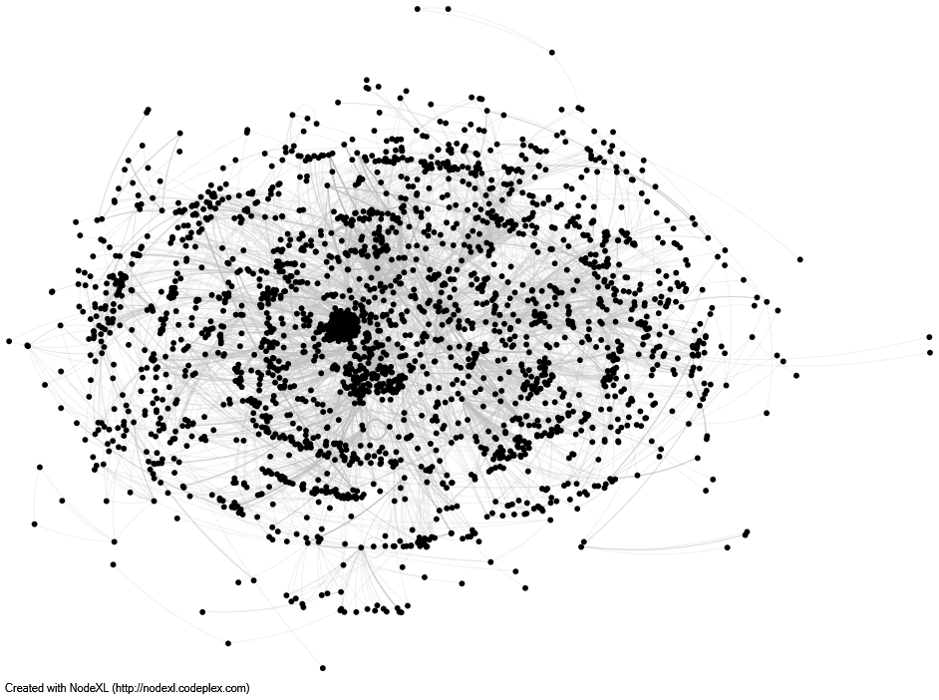
Network Analysis (cont.)
Hashtag network
Hashtag Network
Another network analyzed was the appearance of multiple hashtags in one tweet.
Hashtags are commonly used as one to three word summaries of tweets and analyzing the use of them in combination can help identify topics in the dataset (in addition to Topic Modeling).
The overall hashtag network has a maximum Geodesic distance of 15 and average Geodesic distance of 5.72. It is not considered to be a centralized network.

Slide 31
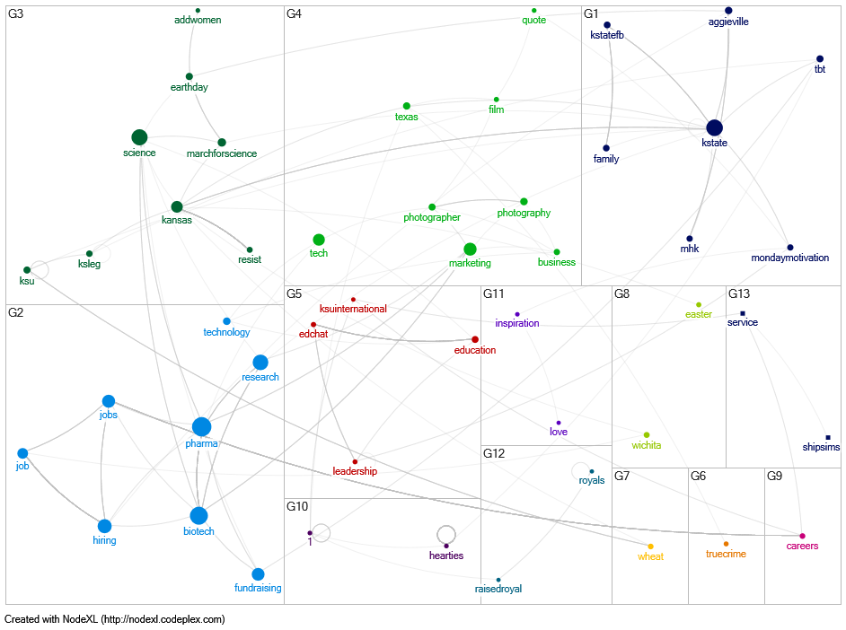
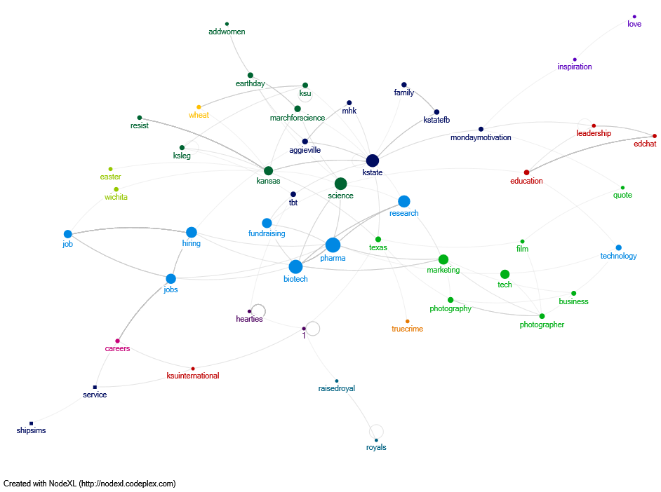
Network Analysis (cont.)
Only key Hashtags group network
Only key Hashtags whole network

Slide 32
Network Analysis (cont.)
Only key hashtag network
Only key hashtag network Top 5 Groups
The maximum Geodesic distance is 8 and the average Geodesic distance is 3.20 when only using the key hashtags. This is a reduction from the overall network being 15 and 5.72 but it is still considered to not be a centralized network and loosely connected.
Group 1
K-State locations, athletics, and memories
Group 2
Pharma/Biotech research, jobs, and fundraising
Group 3
Political activism in Kansas for Science
Group 4
Photography marketing and business
Group 5
Educational leadership, discussion, and education abroad

Slide 33
Project Summary

Slide 34
Project Summary
From April 11, 2017 – April 25, 2017 1,143 Twitter followers of the Kansas State University Foundation discussed topics ranging from the Kansas State University athletics to the Hallmark Channel show “When Calls the Heart” in their collective 29,883 tweets.
Additional topics of note discussed by KSUF Twitter followers were K-State students preparing to graduate and enter the workforce and the Easter holiday that occurred in the observed time period.
Sentiment analysis provided a false negative in this dataset due to the nature of athletic events being discussed in terms of battles and discussing who is injured.
Network analysis centralities were able to make sense of the chaos from the large network by identifying key followers in the network and filtering out the rest.
Secondary research into one of the Key Followers identified shows that the follower has high affinity for Kansas State University and their particular interests are athletics and band.

Slide 35
Closing Observations

Slide 36
Closing Observations
The short time frame used for the data allowed short term topics, such as the Hallmark Channel show “When Calls the Heart” season finale, to potentially have more influence on the findings than it merits. Completing the project again with more of the data acquired should help smooth out the one-off topic noise in the data but will naturally require more processing and analysis time than was available for this assignment.
That is not to say a short time frame of data used is not desired. Using a short term analysis will help identify patterns and unique topics in the data before/if they would appear in longer term evaluations. The use of both short term and longer term data collection periods would be recommended.

